Slide 1
Problem Identification What changes can we implement during this upcoming season that will make up for our $1.5 million increase in operating costs?
Context:
- Big Mountain Resort is a ski resort located in Montana. Big Mountain Resort has recently installed an additional chair lift to help increase the distribution of visitors across the mountain. This additional chair increases their operating costs by $1,540,000 this season
Criteria for Success:
- Changes that will either cut costs without undermining the ticket price or will support an even higher ticket price. These changes must cover for the $1.5 million increase in operating costs

Slide 2
Problem Identification (conti.)
Scope of solution space:
- Changes will be implemented during the upcoming season to make up for the $1.5 million increase in operating costs. Data collected is from 330 resorts in the US within our market share
Constraints within solution space:
- The data has no information about operating costs from any resort. The data has no information about any facilities other than the trams and chairs. The data has no info as to which runs are used most often by customers
Stakeholders to provide key insights:
- Jimmy Blackburn: Director of Operations
Alesha Eisen: Database Manager
Key Data Sources:
- A single CSV file that I got from the database manager

Slide 3
Recommendation and Key Findings
Cuts in operating costs without undermining current ticket price:
- Permanently close the least used run
- Up to one run maybe closed without affecting current ticket price support
Justifications for increasing ticket price:
Adding a new run that would add an additional 150ft to the vertical drop
New run would require a new lift to bring skiers back up
New facilities would support increasing the ticket price by $1.99
Over the season, this would amount to $3,474,638.00

Slide 4
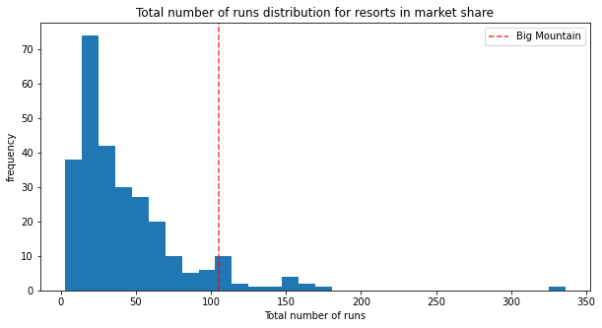
Modeling Results and Analysis
Scenario 1
- Permanently closing the 10 least used runs/ their affect on ticket price support and revenue
1 run = 0.0
2 runs = -0.4057971014492807
3 runs = -0.6666666666666714
4 runs = -0.6666666666666714
5 runs = -0.6666666666666714
6 runs = -1.2608695652173907
7 runs = -1.2608695652173907
8 runs = -1.2608695652173907
9 runs = -1.7101449275362341
10 runs = -1.8115942028985472

Slide 5
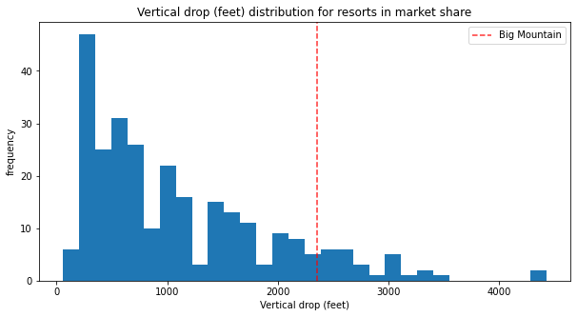
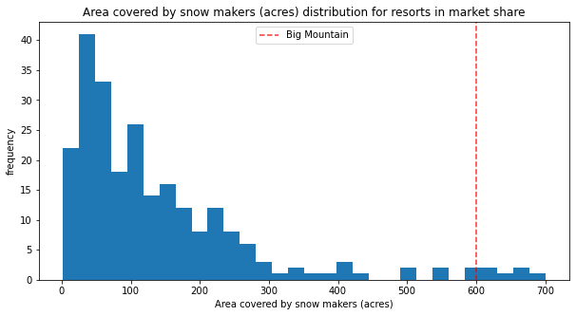
Modeling Results and Analysis
Scenario 2 & 3
Add a run that adds 150ft to the vertical drop; Would require a new lift
These to new facility renovations would support a ticket price increase of $1.99
No new snow coverage would be needed

Slide 6
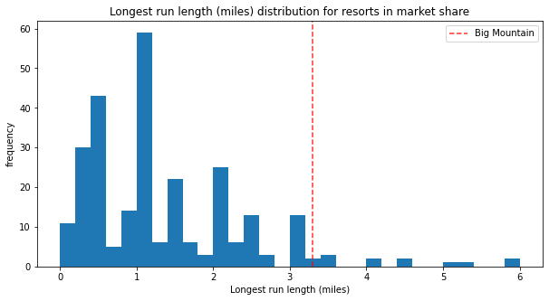
Modeling Results and Analysis
Scenario 4
- Making our longest run longer would have no affect to either the current ticket price or a price increase

Slide 7
Summary and Conclusion
In Conclusion:
Permanently close the least used run
Replace it with a new run that would add 150ft to the vertical drop
Operating costs could be transferred to the new run; Potentially cutting costs
New run and lift would justify increasing ticket price by $1.99; Over the season = $3,474,638.00

